Slide 1

DISTRESS DETECTION THROUGH AUDIO ANALYSIS AND ALERT TRIGGERING
welcomes non distress world

Slide 2

Team Members
CH.GOWTHAM SAI 99210041386
CH.CHETAN 99210041670
CH.BHAVANA 99210042034
K.KUSHMA 9921004350

Slide 3
ANALYSIS OF PROBLEM STATEMENT
We live in a noisy world where sounds generated by humans or animals sometimes can indicate distress.
The Importance of Distress Detection Humanitarian
Early detection of distress signals means faster rescues, reduced pain and trauma, and better outcomes for victims.
Medical Distress signals can indicate acute and chronic medical conditions. Early detection can lead to faster interventions and better outcomes.
Safety Distress signals in public areas can indicate threats to safety and security. Timely alerts can help mitigate risks and prevent disasters.

Slide 4
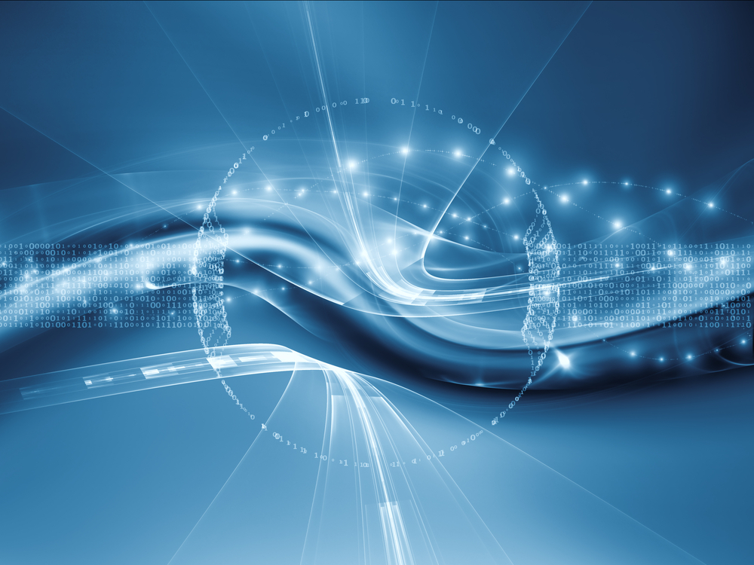
Technology used
Essential requirement of our project
python 3.7
Librosa
Pytorch
Keras
GPU
HTML
CSS
JAVASCIPT

Slide 5
implementation
Data collection
Here the need of the is to generate alert to save them from the emergency.
Firstly we ask the users to give details of persons to contact who are very close to them and with allowance of the user we make the contact to the government servants.
Collect a diverse dataset of audio samples containing different types of distress sounds, including screams and aggressive sounds. Preprocess the audio data by converting it into a suitable format and extracting relevant features. Features might include spectral characteristics, MFCCs (Mel-Frequency Cepstral Coefficients), and other acoustic features that can capture the unique aspects of distress sounds.

Slide 6
Feature Extraction:
Use signal processing techniques to extract meaningful features from the audio data. These features should be able to capture the specific patterns and characteristics of distress sounds. Feature extraction techniques could include Short-Time Fourier Transform (STFT), Mel-frequency analysis, and more.
Machine Learning Model:
Train a machine learning model to classify distress sounds based on the extracted features. You can use various algorithms such as convolutional neural networks (CNNs), recurrent neural networks (RNNs), or more advanced models like hybrid CNN-RNN architectures. The model should be trained on labeled data that includes examples of distress and non-distress sounds.

Slide 7
Data Labeling:
Annotate your dataset with appropriate labels indicating whether each audio sample contains distress sounds or not. This step is crucial for supervised learning, as it provides the ground truth for training and evaluation.
Model Training:
Split your labeled dataset into training and validation sets. Train your chosen machine learning model on the training set and fine-tune its hyperparameters using the validation set. Use appropriate evaluation metrics (e.g., accuracy, precision, recall) to measure the model's performance.

Slide 8
Alert Generation:
Integrate an alert generation system into your model. When the model detects distress sounds, it should trigger an alert. This alert could be in the form of notifications sent to designated individuals, emails, text messages, or even automated responses to connected devices.
Threshold Setting:
Set appropriate thresholds for distress sound detection. Depending on your model's output (e.g., probability scores), you'll need to decide when the system should consider a sound as distressful enough to trigger an alert. This threshold might need tuning to balance false positives and false negatives.

Slide 9
Real-time Processing:
Implement real-time audio processing to analyze incoming audio streams. This could involve buffering audio data and running it through the trained model in chunks or frames to continuously monitor for distress sounds.
Testing and Validation:
Test your system with a variety of distress sounds and non-distress sounds to ensure its accuracy and reliability. Continuously validate and fine-tune your model as needed.

Slide 10
Deployment:
Deploy your system in the intended environment where it will be monitoring for distress sounds. This could be in various contexts, such as public spaces, security applications, or healthcare settings.
Remember that building such a system involves technical expertise in signal processing, machine learning, and possibly hardware integration for real-time processing. Additionally, ethical considerations should be taken into account, including user consent, privacy concerns, and potential biases in the training data.

Slide 11
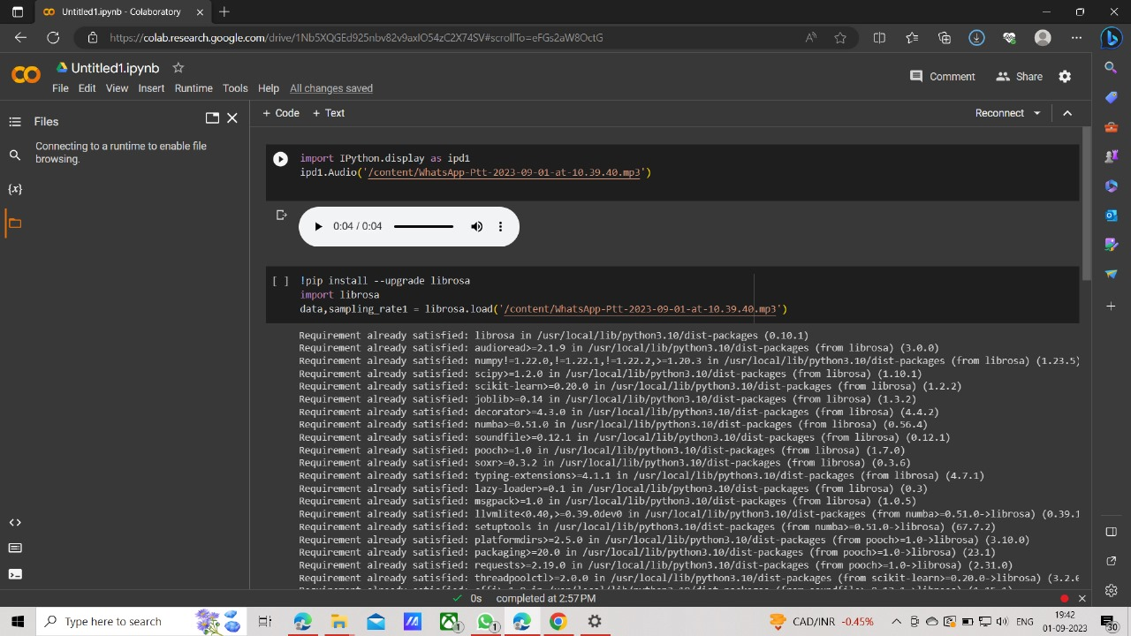
Demonstration of the model
data collection
audio data is captured from different sources such as microphones ,smartphones , or security cameras. the data is preprocessed to remove noise ,echos or other artifacts.

Slide 12
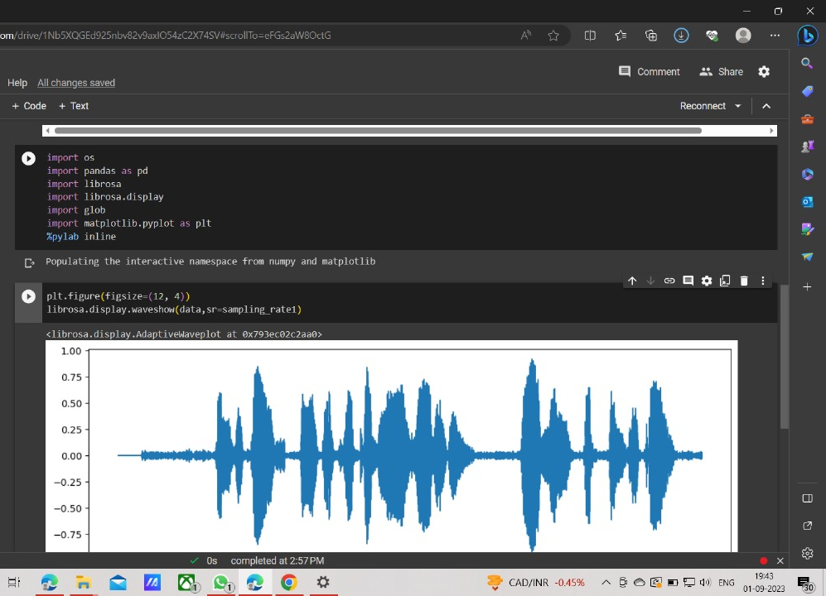
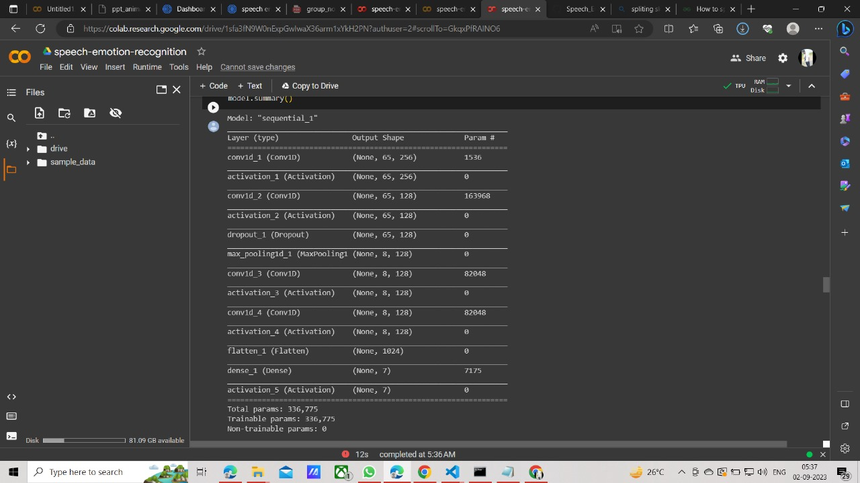
Feature Extraction
Audio signals are transformed into a set of relevant features (e.g., pitch, volume, duration, frequency). These features are used to train machine learning algorithms.
Classification Machine
learning models are trained using labeled data. Unsupervised learning can also be used to detect unknown types of distress signals

Slide 13
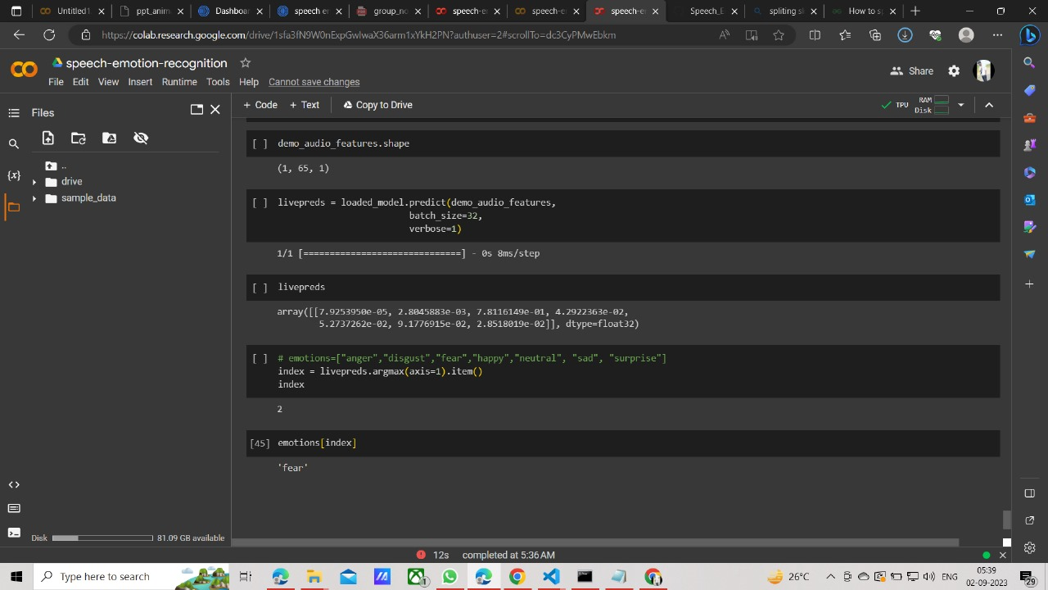
Alerts and Feedback
When a distress signal is detected, a set of predefined alerts is triggered. Feedback is provided to the system to continuously improve its accuracy and performance.
Real-time Processing:
Implement real-time audio processing to analyze incoming audio streams. This could involve buffering audio data and running it through the trained model in chunks or frames to continuously monitor for distress sounds.

Slide 14
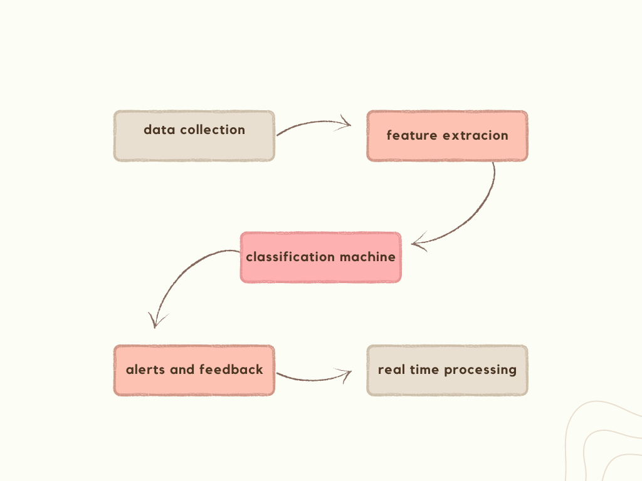
Simple flowchart

Slide 15
NOVELTY
One such technology is an automated speech processing system that detects distress in people to enable early referral for interventions to target anxiety and depression, to mitigate suicidal ideation and to improve adherence to treatment.
Latest advances in artificial intelligence and machine learning is to detect distress signals with high accuracy and speed.

Slide 16
innovativeness
We aim to provide real-time feedback to users about their distress levels and coping strategies. We use machine learning and natural language processing to analyze audio and text data.
We are exploring different types of sensors such as video, thermal, or heart rate to complement audio analysis and improve distress detection.
We are investigating ways to compare distress signals across different species (e.g., humans, dogs, birds) to identify common features and patterns.

Slide 17
Societal impact
Caregivers
Family members or professional caregivers can receive alerts via mobile or web apps. The system can also provide them with information about the type and severity of distress signal.
Emergency Services
When a distress signal is detected, the system can trigger an automated call to the nearest emergency services (e.g., ambulance, police, fire department).
Building Security
Security personnel can be alerted when distress signals are detected in public areas such as parks, malls, or universities. The system can also direct them to the exact location of the signal.

Slide 18
BUSINESS PROTOTYPE
Partnerships
We partner with hospitals, nursing homes, animal sanctuaries, and other organizations to pilot-test our system and gather feedback.
Subscription model
We offer a subscription-based service with different pricing plans depending on the number of sensors and alerts needed.
Sustainability
We are committed to sustainability and social responsibility. A portion of our revenue is donated to organizations working towards animal welfare and human rights.

Slide 19
CONCLUSION
In conclusion, this stress prediction analysis provides valuable insights into stress levels and their prediction using machine learning. Use the findings to develop tools and interventions for stress management, promoting overall well-being and improved quality of life. Thus we can more problems solved without human efforts. Safety Distress signals in public areas can indicate threats to safety and security. Timely alerts can help mitigate risks and prevent disasters.

Slide 20
Thank you

